Slide 1
UPDATES ON THE DEVELOPMENT OF THE SADC MODEL LAW ON PUBLIC FINANCIAL MANAGEMENT
Ms B.Sekgoma
Secretary General, SADC Parliamentary Forum
Tuesday 25th October 2022

Slide 2
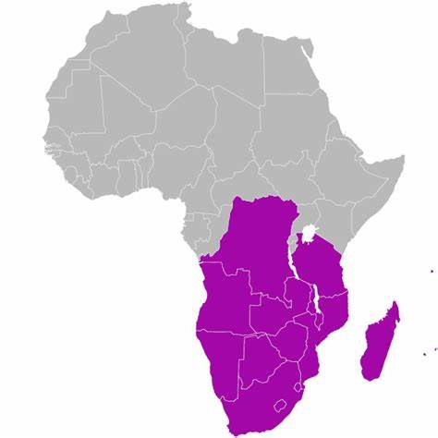
VISION OF THE FORUM WITH REGARDS TO PFM
The Forum is composed of 15 Member Parliaments, and is constituted of democratically elected representatives.
The last Member to join the Forum in December 2019 was the Parliament of Madagascar.
The Vision of the Forum is to act as “the Flag-Bearer of Democratisation and Socio-Economic Development in the SADC Region”.
The Forum Membership came to the realization that there can be no sustainable socio-economic development without a strong democratic base which is founded on good governance and accountability through sound PFM.

Slide 3
RATIONALE OF THE SADC MODEL LAW ON PFM
The SADC Model Law on PFM was adopted by the 51st Plenary Assembly of the Forum which took place from the 7th-15th July 2022 in Lilongwe, Malawi.
As cited in the Explanatory Notes of the Model Law, the overall objective of the Model Law is to:
“..Ensure that SADC national Parliaments are enabled to conduct their legislative, budgetary and oversight functions for public financial management in a way that is transparent, efficient and responsive to the needs of SADC citizens.”
In other words, the Model Law is to empower national Parliaments, including the PAC, to monitor PFM.
The Model Law is an instrumental aid to the PAC which can be used to promote PFM.

Slide 4
KEY FEATURES OF THE MODEL LAW
Empower public account committees
Promote performance based budgets with clear Key performance indicators
Promote reporting on international commitments through the budget
Exercise a measure of control over the debt ceiling of government

Slide 5
EMPOWERING OF THE PUBLIC ACCOUNTS COMMITTEE
Across SADC Member States, it was revealed that on many instances, PACs were really only reviewing the report of the Auditor General, thus leaving out the auditing of other public bodies, departments or statutory bodies which are also publicly funded.
Section 52 of the Model Law ensures that the PAC can also review the reports of other departments and public authorities, thus leaving no loophole in the PFM system.
The Model Law also leaves the option open for Member States to include State Owned Enterprises under the ambit of the PAC, depending on circumstances.
In addition, the PAC is supported by a complaints system (section 53) and a whistle blowing policy (section 55).
The PAC is also vested with enforcement powers which enable it to call attendees formally to give evidence (section 54) and to liaise with enforcing or regulatory agencies.

Slide 6
PROMOTING PERFORMANCE BASED BUDGETS
PACs are concerned with ensuring that public expenditure occurs in the manner which has been approved by Parliament.
Performance-based budgets (PBB) with clear Key Performance Indicators thus give an indication as to how public expenditure is to occur.
PBB is thus a necessary feature of modern budgets and is referred to in the Explanatory Notes of the Model Law.
The Model Law alludes to the fact that the PBB requirement can be expressed through different means by Member States, such as:
Law
Administration;
Arrangements with the Ministry of Finance

Slide 7
PROMOTE REPORTING OF INTERNATIONAL COMMITMENTS
International Commitments include:
Regional treaties and conventions;
Declarations and Ministerial Commitments;
The Sustainable Development Goals, Africa Agenda 2063 etc
SCARCELY REPORTED THROUGH BUDGETS, yet international commitments are linked to the budget.
The Model Law proposes the submission of Statements which accompany the Budget document and which gives information on responsiveness of the budget to the identified commitments (section 66 of the Model Law).
PACs can also choose to monitor compliance with such statements which would be a legal requirement whenever budgets are passed in Parliament.

Slide 8
MEASURE OF CONTROL OVER DEBT CEILING OF GOVERNMENT
The debt ceiling is a crucial feature to assess a country’s financial stability.
Some countries’ debt ceiling in the world has exceeded 300% of GDP, causing them to be declared bankrupt.
To date, Governments elected by a majority can enter into contracts worth billions, thus binding successive Governments over 20-30 years.
The Model Law provides for PACs to exercise control over the public debt in case it exceeds, or appears to exceed, the debt ceiling which is to be 60%, reduced to 50% within a period of 5 years (sections 91 to 93 of the Model Law).
Section 93(2) provides that the Public Accounts Committee shall publish and maintain a strategy (“the public debt Parliamentary oversight strategy”) for—
(a) monitoring the accrual of public debt;
(b) overseeing the management and servicing of public debt; and
(c) making recommendations for the reduction and control of public debt.

Slide 9
WAY FORWARD & CONCLUSION – DEVISING DOMESTICATION STRATEGIES
The previous slides are a flavour of the Model Law from a PAC perspective. The Model law on PFM contains other interesting features such as a general framework to regulate cryptocurrencies & rules on procurement.
The way forward is to work together with partners to ensure a progressive domestication of the Model Law.
Partners such as the SADCOPAC and Chairpersons of national PACs are invited to work together with the Forum to devise sustained domestication strategies.

Slide 10
THANK YOU FOR YOUR ATTENTION
Questions are welcome

